Slide 1
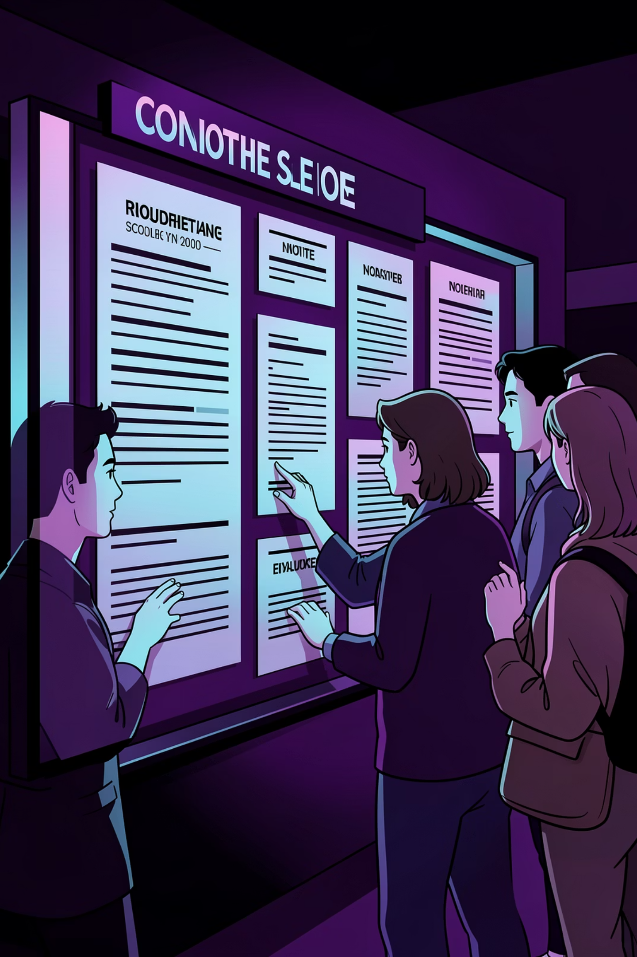
College Notice Board Web Application
Presented by: Madhura Mahesh Mane,
Computer Engineering [2nd year]
Guided by: Vaishnavi Atole

Slide 2
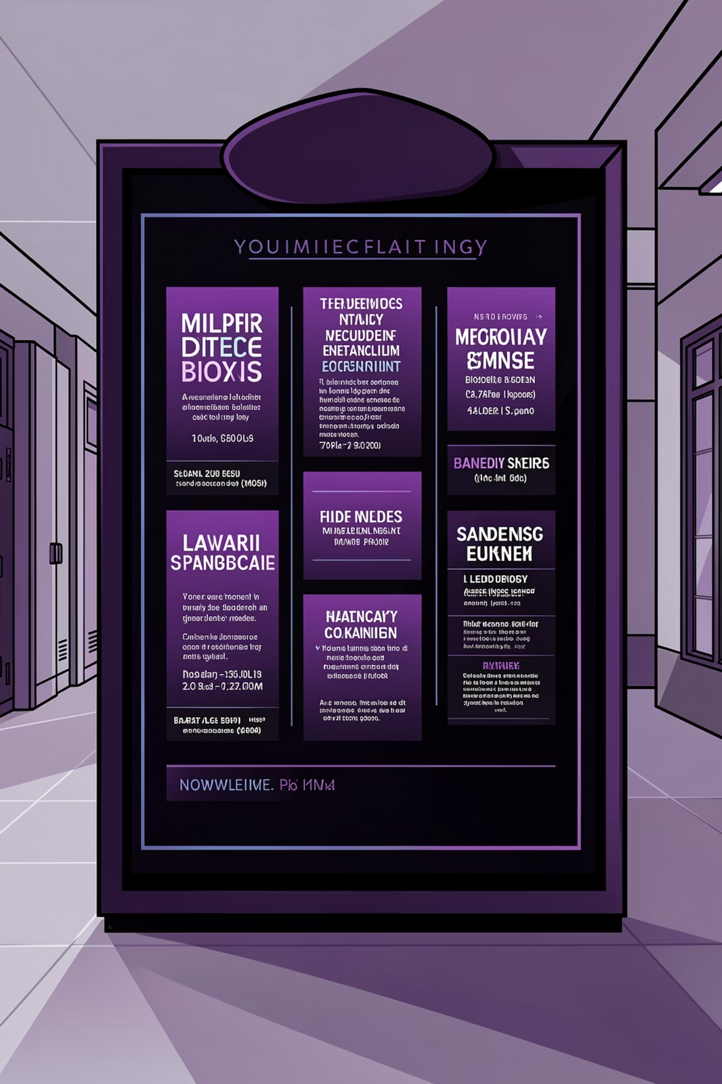
Introduction: Evolving Campus Communication
Traditional notice boards, whilst familiar, often lead to outdated information, limited visibility, and administrative burdens. Their static nature fails to keep pace with the dynamic flow of campus life.
Our project introduces a digital solution, transforming the way college announcements are shared. It offers a modern, efficient, and accessible platform for all campus communications.

Slide 3
Project Objectives: Enhancing Campus Connectivity
1
2
Real-time Updates
Centralised Platform
Ensure instant dissemination of crucial information to all students and staff.
Create a single, easily accessible hub for all official college announcements.
3
4
User-Friendly Interface
Reduced Paper Waste
Develop an intuitive design for both administrators posting and users viewing notices.
Contribute to environmental sustainability by digitising all campus notices.

Slide 4






Tools & Technologies: Building the Foundation
Our web application was developed using a robust stack of modern programming languages and frameworks, ensuring both functionality and a responsive user experience.
HTML5
CSS3
JavaScript
Django
Structuring the web content.
Styling for visual appeal.
Interactive front-end elements.
Powerful backend framework.
Bootstrap
SQLite
Responsive design for all devices.
Efficient, lightweight database management.

Slide 5

System Design: A Blueprint for Interaction
Both interact with DB
Admin creates notice
Read/write via secure API
Authorises and publishes content
Notice Management Flow
Database stores notices
Student views notice
Persists records and metadata
Retrieves and reads published notice
The system is designed with distinct user roles, ensuring secure and organised content management. Administrators are responsible for creating and publishing notices, whilst students can effortlessly access and view them.

Slide 6
Key Features: Intuitive and Dynamic
Real-time Updates
User Authentication
Categorised Notices
Search Functionality
Notices are published and visible instantly.
Secure login for administrators and students.
Easy filtering of notices by department or event type.
Quickly find specific announcements.
Responsive Design
Optimised viewing across desktops, tablets, and mobiles.

Slide 7
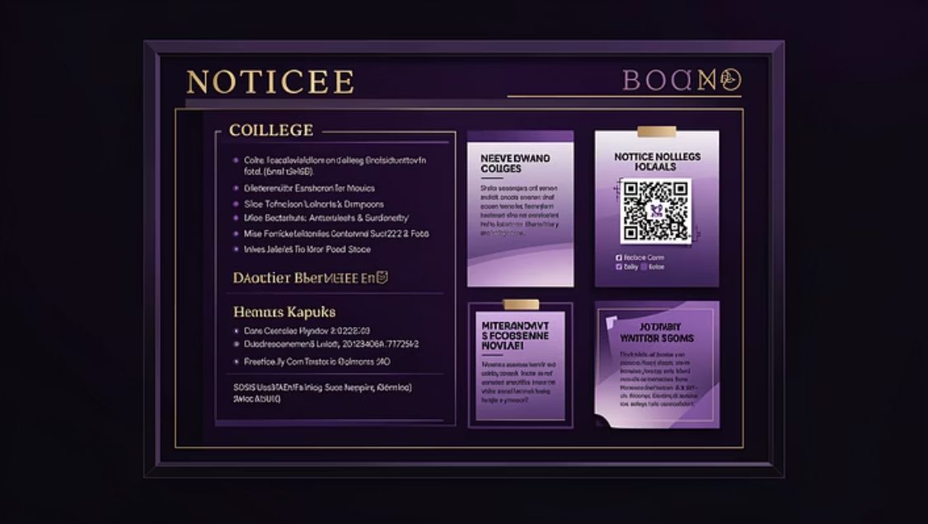
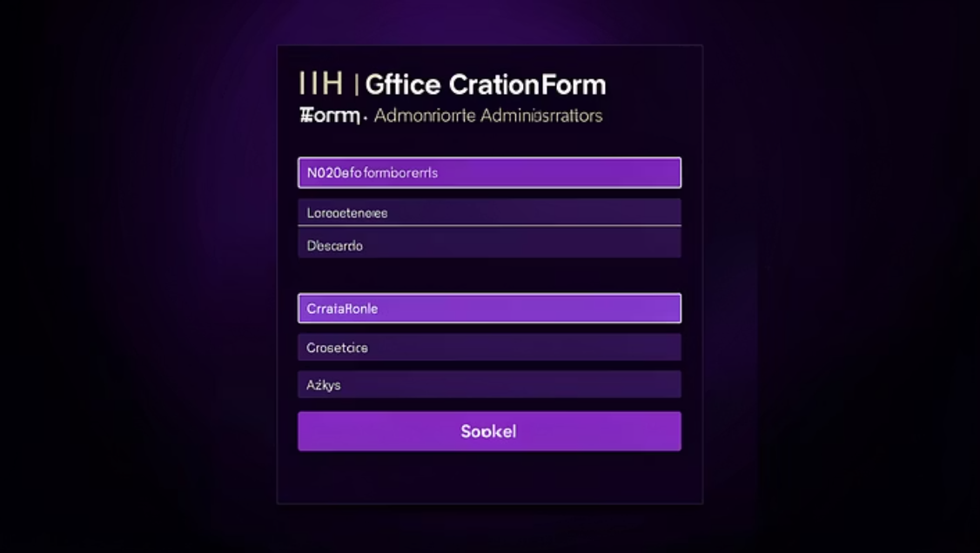
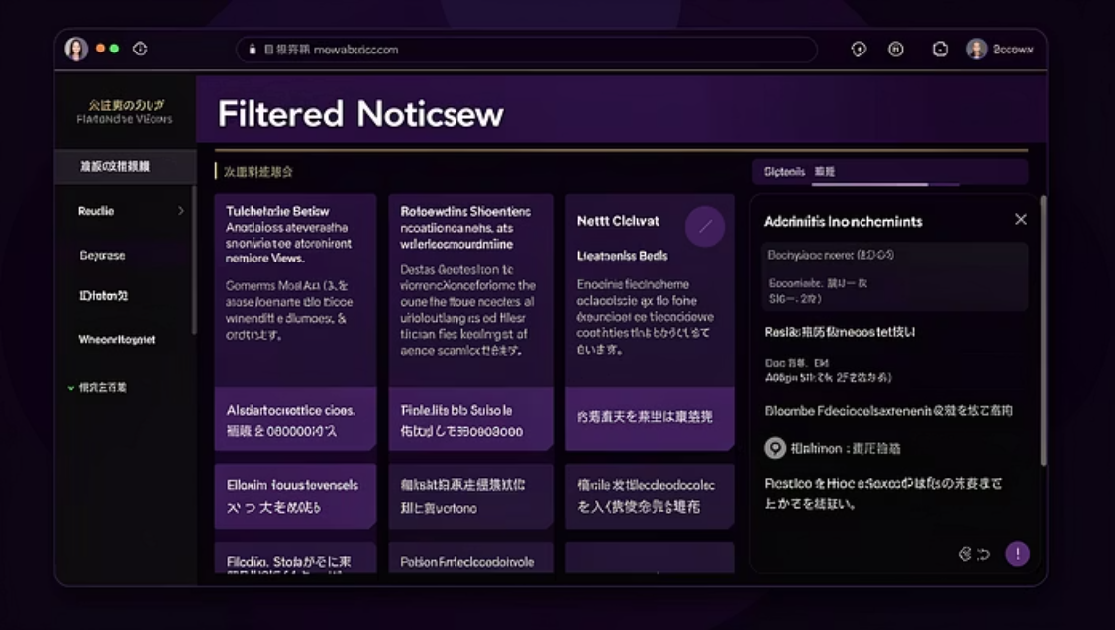

A Glimpse of the Application: Screenshots
Explore the visual interface of our College Notice Board Web Application, showcasing its clean design and user-friendly navigation.

Slide 8

Challenges Faced: Overcoming Obstacles
Database Optimisation
Responsive Design
Ensuring efficient data retrieval and storage as the number of notices grows.
Achieving a seamless experience across diverse devices and screen sizes.
Security Implementation
Integration Complexity
Protecting against common web vulnerabilities and ensuring data integrity.
Harmonising different technologies (Django, JS, CSS) to work cohesively.

Slide 9

Conclusion & Future Scope
Achievements
Future Enhancements
Our project successfully delivers a modern, efficient, and accessible digital notice board. It significantly improves campus communication and reduces reliance on traditional, less effective methods.
Integration with college calendar for event reminders.
Push notifications for urgent announcements.
Multi-language support for diverse student populations.
Feedback and comment sections for notices.
Improved information dissemination
Enhanced user experience
Sustainable communication solution

Slide 10

References: Further Reading & Resources
For detailed information on the technologies and concepts used in this project, please refer to the following resources:
Django Documentation
MDN Web Docs: HTML
MDN Web Docs: CSS
MDN Web Docs: JavaScript
Bootstrap Official Documentation
SQLite Documentation
Academic papers on web application security and database design.

